Slide 1
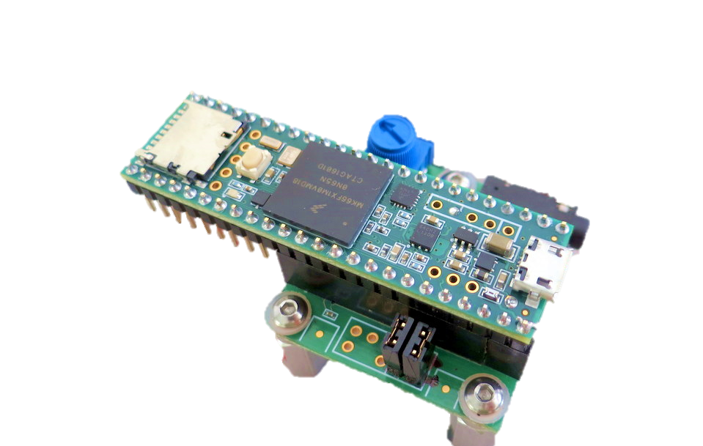
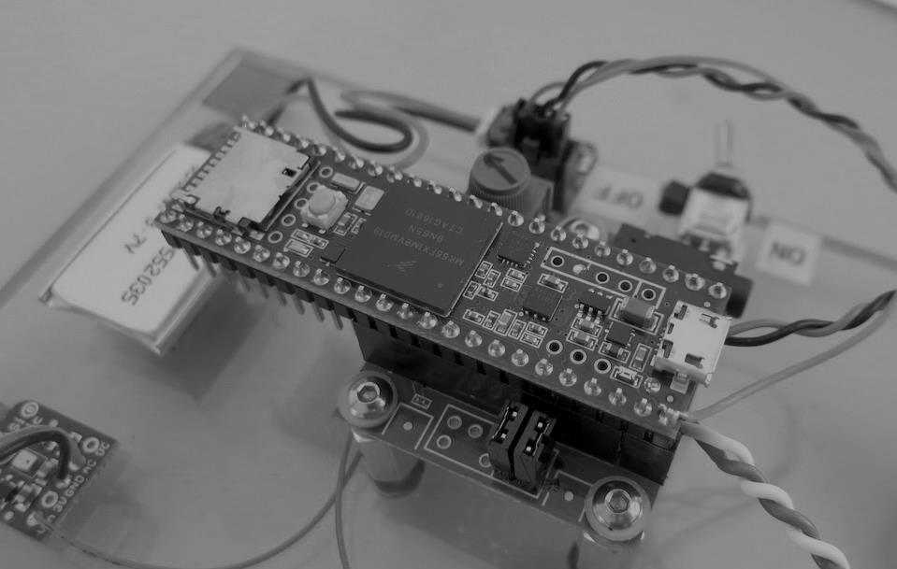
Measuring Self-Noise
Teensy Audio
Board
Shorted
Inputs

Slide 2
